Slide 1


Dibyajyoti Ghosh
Los Alamos National Laboratory
Charge Carrier Dynamics in Hybrid Perovskites:
Insights from NAMD Simulations
LA-UR-20-21858

Slide 2
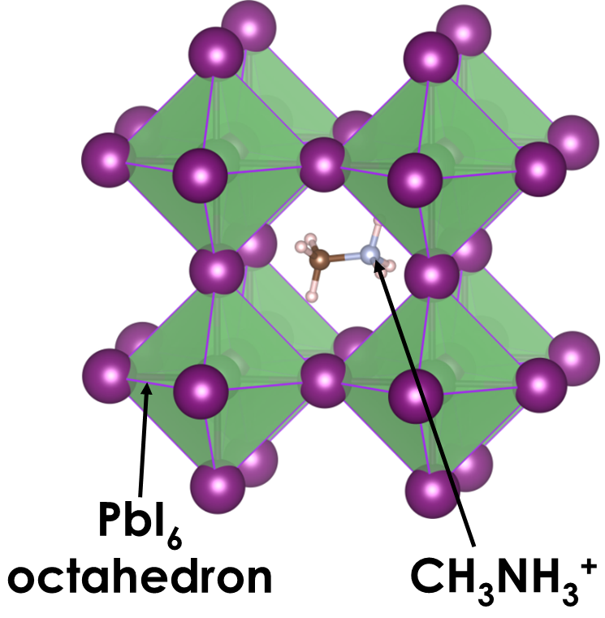
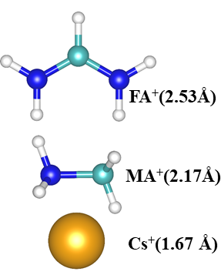
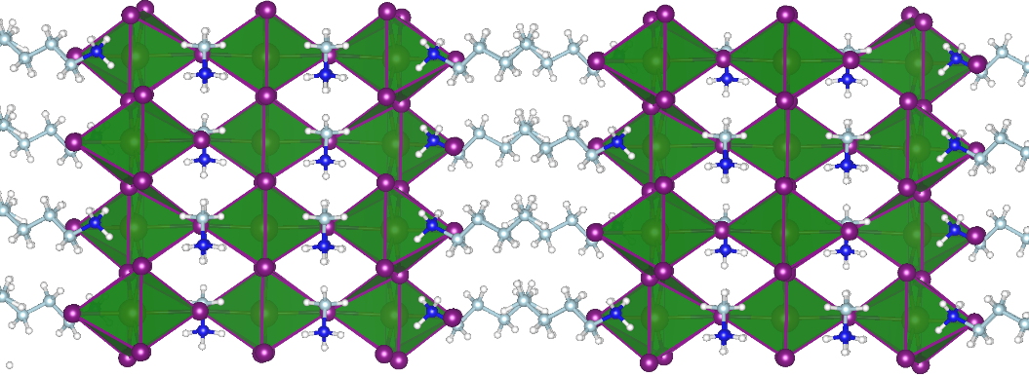
Organic-Inorganic Perovskite
A cations
Solution processable
Strong absorption
Excellent charge transport
Defect tolerant
Tunable Dimensionality
B metals: Pb, Sn
Methylammonium lead iodide CH₃NH₃PbI₃
Kojima et al. J. Am. Chem. Soc, 2009, 131, 6050
Eames et. al. Nature Comm. 2015, 6, 7497
Lin et al. Science, 2020, 369, 6499
Layered Perovskites (2D)
Quantum Dots (0D)
Raino et al. Nature, 2018, 563, 671
Swarnkar et al. Angew. Chem., 2015, 127, 15644
Tsai et al. Nature, 2016, 536, 7616
Shi et al. Nature, 2020, 580, 614

Slide 3
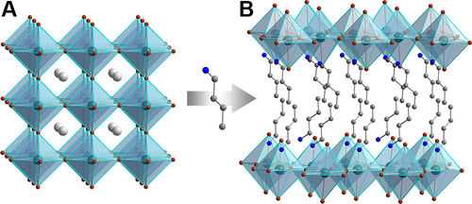
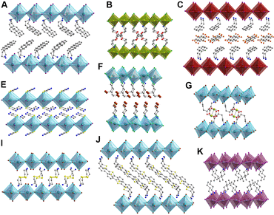
2D-halide perovskites
Conceptual slicing of a 3D-perovskite
Improved stability
Higher crystallinity and fewer defects
Promising light absorption and emission
Wide diversity in crystal structure and emission properties
Grancini et al. Nat. Rev. Mater., 2019, 4, 4;
Smith et al. Chem. Rev, 2019, 119, 3104

Slide 4
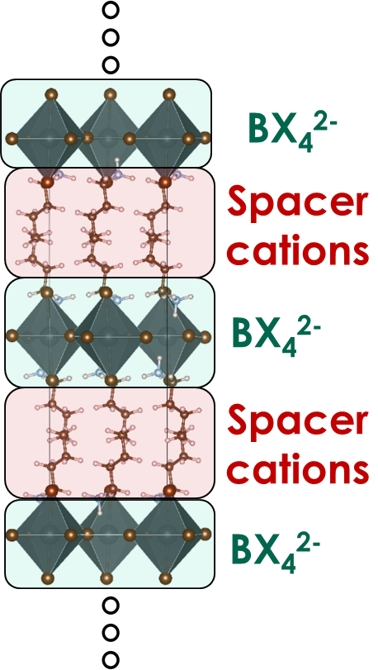
Two-dimensional perovskites for Optoelectronics
Partially known complex nature of carrier recombination dynamics
What is the role of spacer cations on the carrier recombination processes ?
B = Pb, Sn
X = Cl, Br, I
Tsai et al. Nature 2016, 536, 312; Blancon et al. Science 2017, 355, 1288; Tsai et. al, Science Advances 2020, 6, 0815

Slide 5
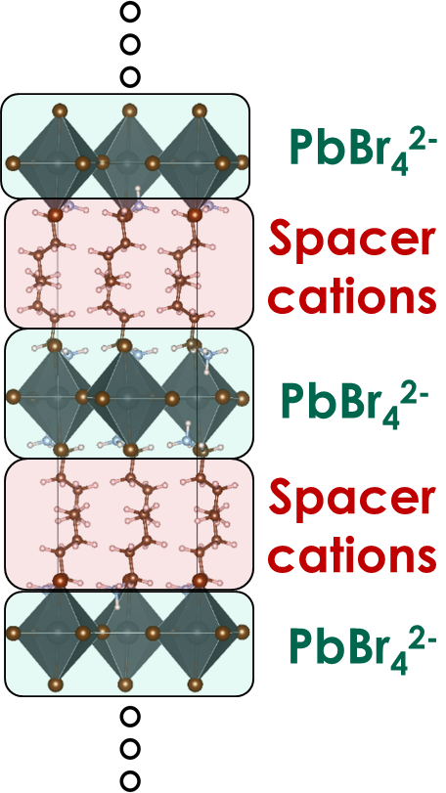
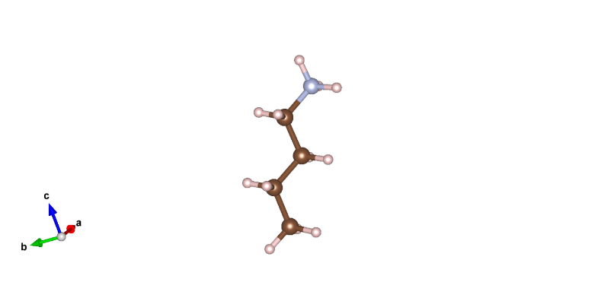
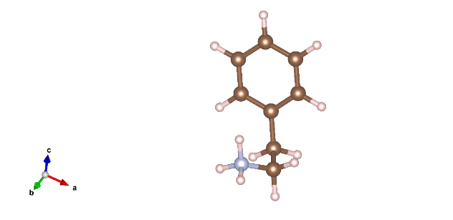
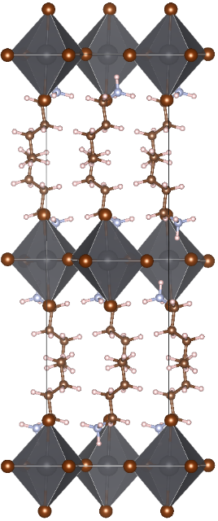
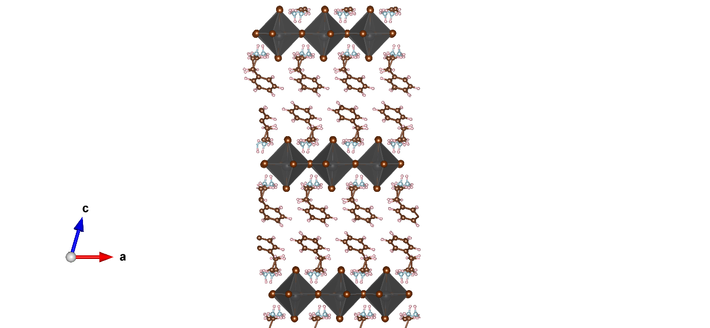

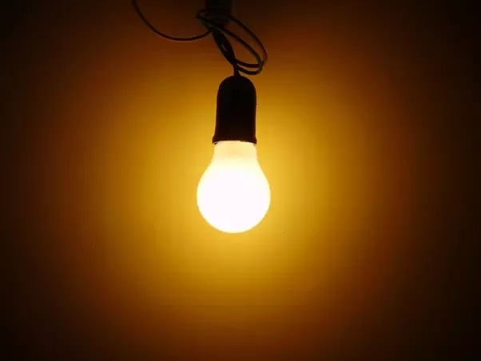
Different Spacer Cations in 2D perovskites
BA
(Alkyl chain)
PEA
(Benzene ring)
BA⁺
PEA⁺
BA⁺
PEA⁺
Well studied and distinctly different optoelectronic (LED, detectors) performances
Similar crystal structure and static electronic properties
Takagi et al. Phys. Rev. B, 2013, 87, 125421
Gong et al. Nature Mater, 2018, 17, 550

Slide 6
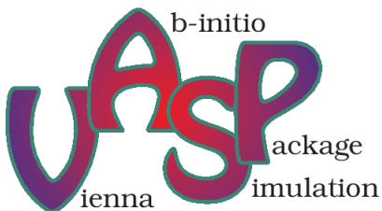

Key Questions
How spacer cations impact the electronics?
Influences in structural dynamics?
What about non-radiative recombination rates?
Methods
Density functional theory &
ab initio molecular dynamics
Non-adiabatic molecular dynamics
j
Static Structure and Properties with DFT
Structural Fluctuations with AIMD
E
i
t

Slide 7
Computational Approach
AIMD (with VASP)
Step 1: Optimize the structure at 0 K
Step 2: Gradually heat the lattice to 300 K
Step 3: Keep the lattice at 300 K and generate the trajectory (NVE ensemble)
Calculate non-adiabatic coupling constants (with VASP)
Step 1: Separate the trajectory in smaller fragments
Step 2: Calculate adiabatic state energies and NA coupling between states
NAMD simulation (with PYXAID)
Calculate the change of state populations over time. Used classical path approximation and decoherence induced surface hopping (DISH).

Slide 8
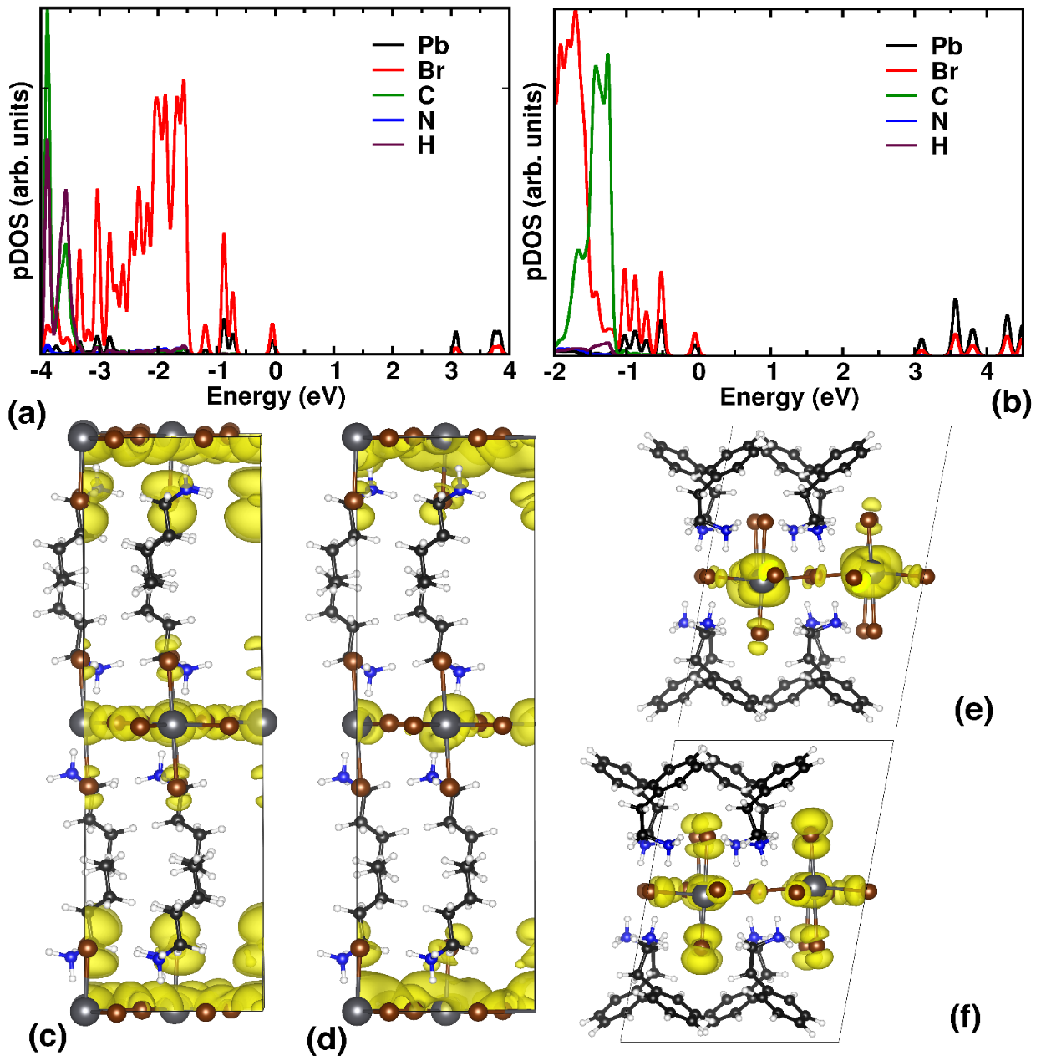
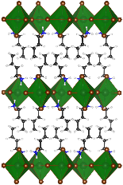
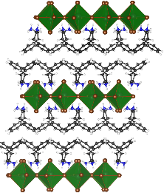


Static Electronic Properties
(BA)₂PbBr₄
(PEA)₂PbBr₄
DFT, 0 K
Similar band gaps
Molecular states are well below (>1eV) to band-edges
PEA states are relatively closer to VBM
3.13 eV
3.14 eV
CBM
VBM
VBM
CBM
Ghosh et al. J. Phys. Chem. Lett, 2020, 11, 2955

Slide 9

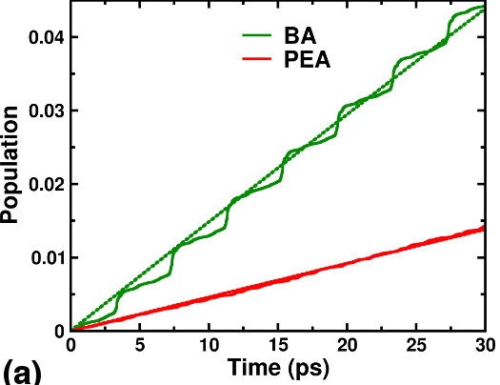
Impact of Spacer Cations on Carrier Dynamics
Population of electron-hole recombined state through non-radiative processes (dominant loss mechanism)
(BA)₂PbBr₄
Recombined carrier
(PEA)₂PbBr₄
Much faster non-radiative recombination for (BA)₂PbBr₄
Ghosh et al. J. Phys. Chem. Lett, 2020, 11, 2955;
Ghosh et al. J. Mater. Chem. A, Just Accepted, 2020

Slide 10
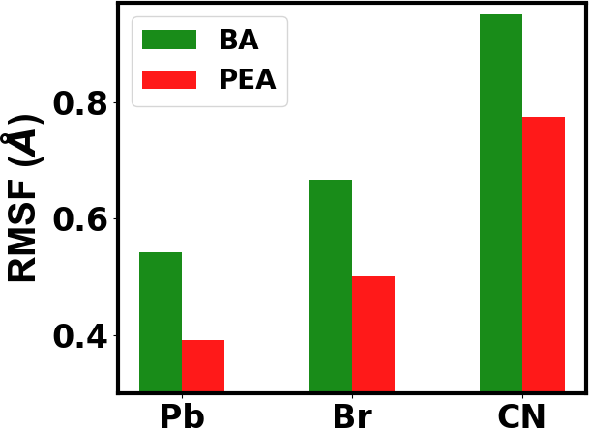
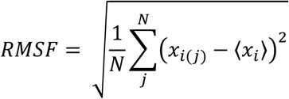
Spacer Cation Dependent Structural Dynamics
AIMD, 300 K
BA cations make PbBr-layer more dynamic
(PEA)₂PbBr₄ is more rigid; π stacking interactions
Ghosh et al. J. Phys. Chem. Lett, 2020, 11, 2955

Slide 11
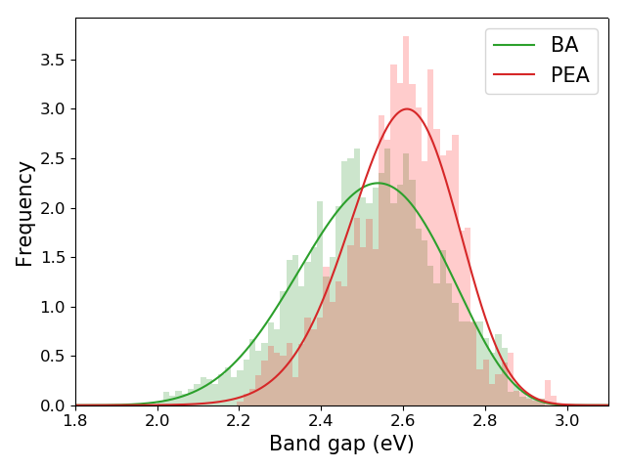
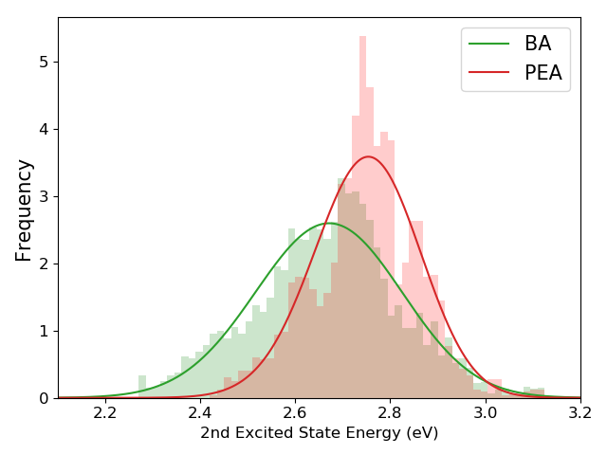


Dynamic Electronic Properties
CBM
VBM
Band gaps and excited states fluctuate more for BA-based perovskites
Strong influence of dynamic structures on the electronic properties

Slide 12
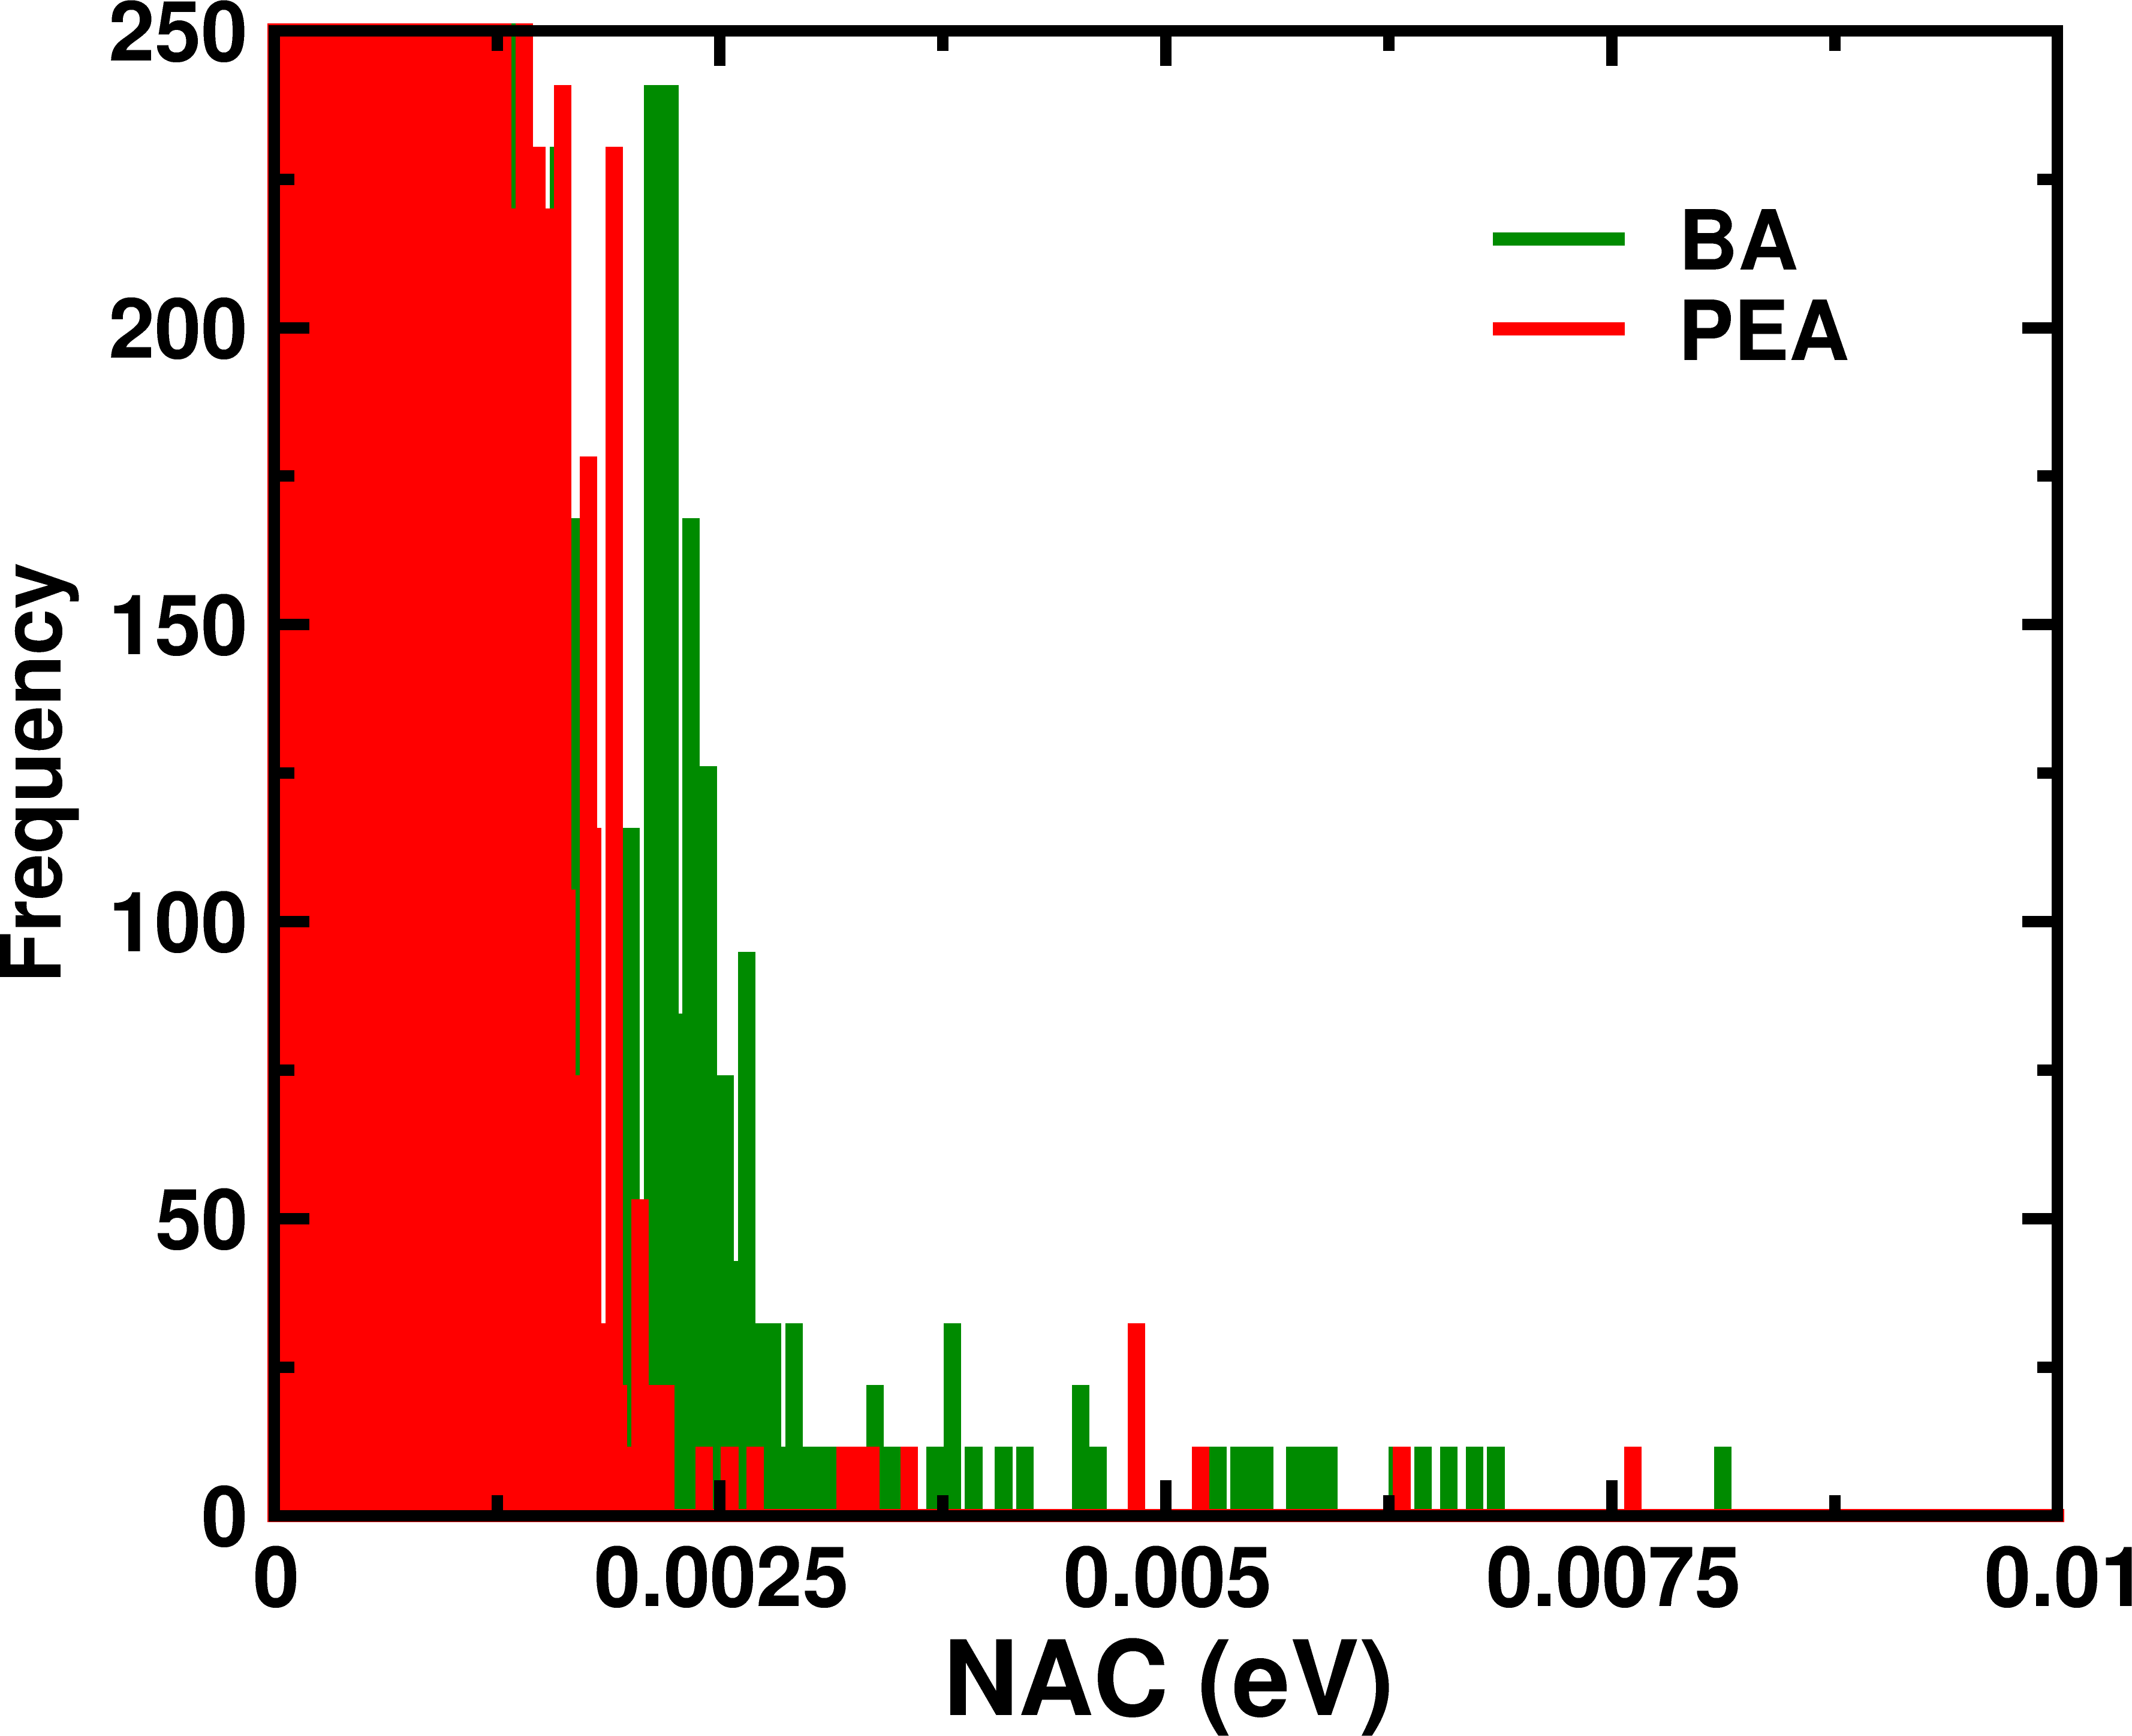
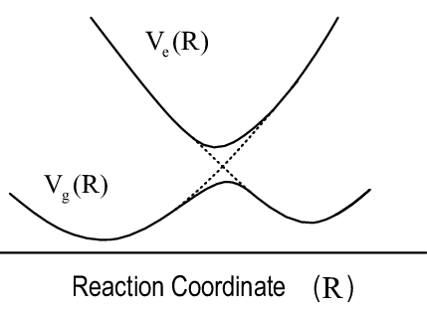
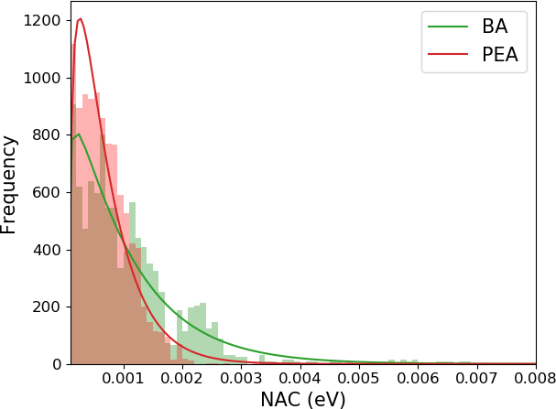
Non-adiabatic Coupling
More number of large NAC values for (BA)₂PbBr₄
Dynamic (BA)₂PbBr₄: Stronger electron-phonon interactions, more active non-radiative processes

Slide 13
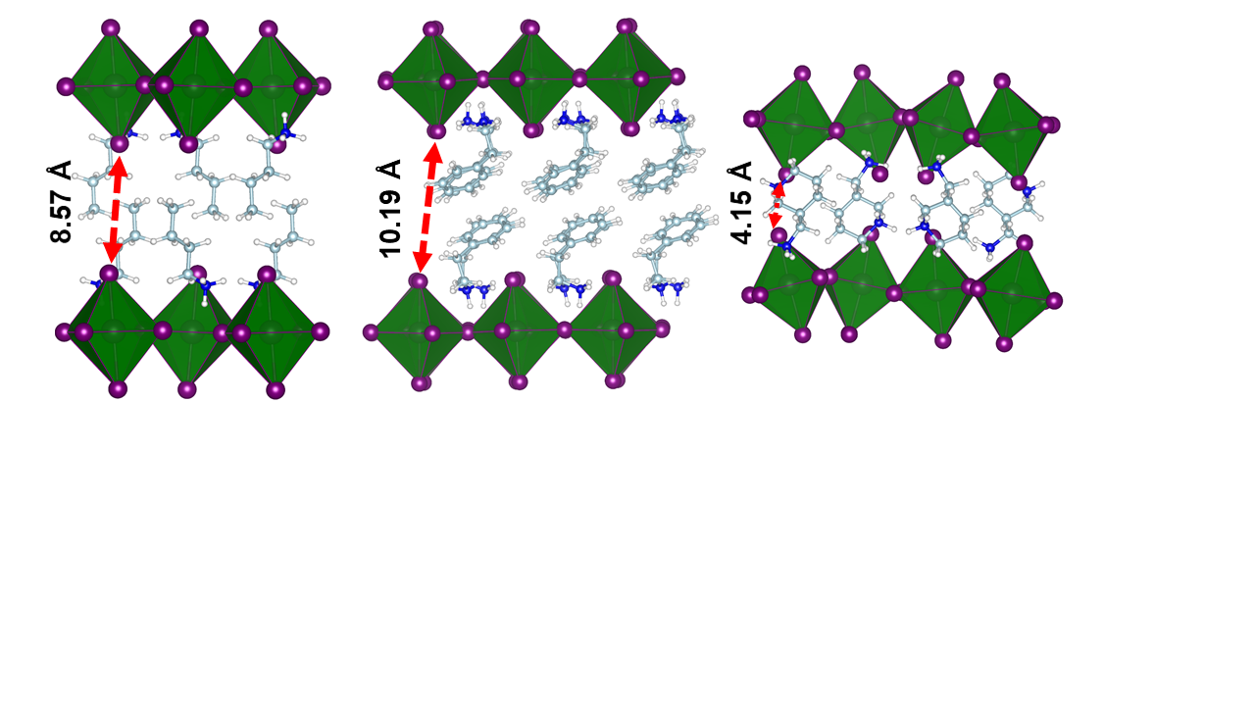

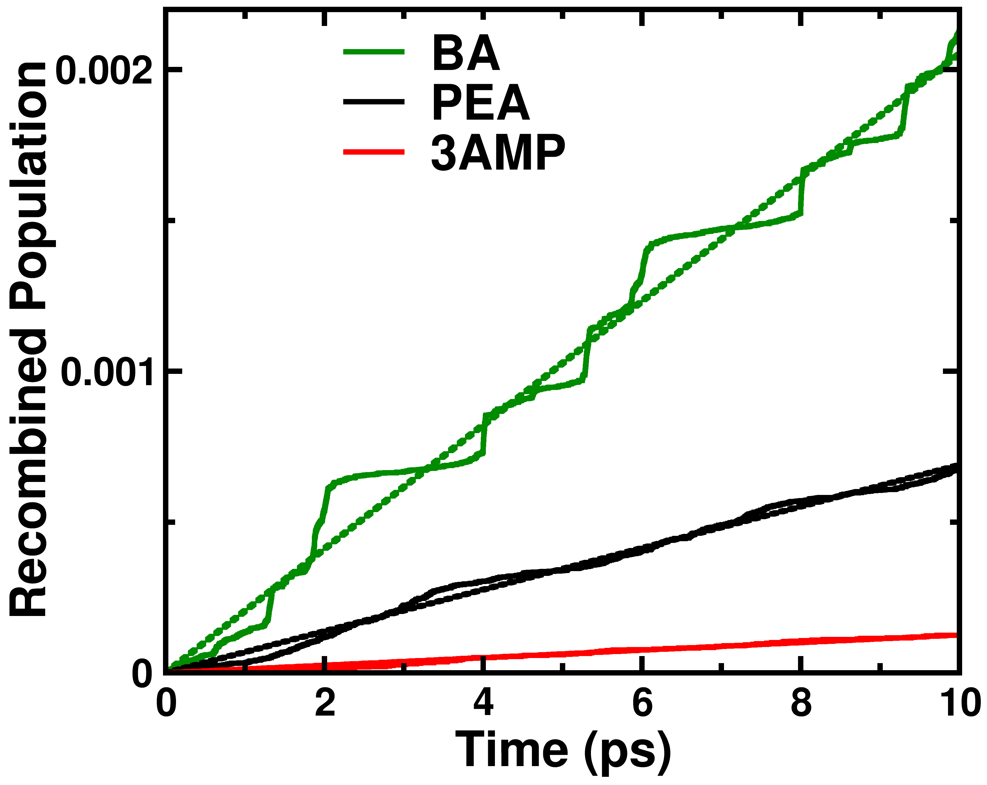

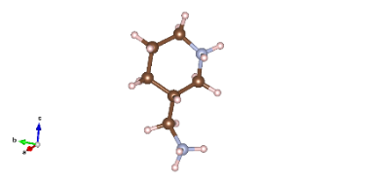
Next Step: In silico materials designing for efficient 2D Iodide perovskites
BA⁺
PEA⁺
3AMP²⁺
Two spacer cations/unit;
Non-covalent stacking
Single spacer cation/unit;
stiff stacking
(A)₂PbI₄
BA
(Most dynamic)
(A)PbI₄
Design Strategy for 2D halide perovskites:
Compact the interlayers, mitigated fluctuations; slower the non-radiative recombination
3AMP (Stiffest)
Ghosh et al. Accepted, J. Mater. Chem. A 2020

Slide 14
2D-halide Perovskites for Optoelectronics
Dynamic structures influence the charge carrier recombination processes: Strategic structural modifications can mitigate non-radiative losses

Slide 15


Group & Collaboration
Dr. Sergei Tretiak and Dr. Amanda Neukirch (LANL)
Prof. Oleg Prezhdo (USC)and group
Dr. W. Nei (LANL)

